Slide 1
Navigating the Moon:
Using Deep Reinforcement Learning to play Lunar Lander
Jonathon Bowyer

Slide 2
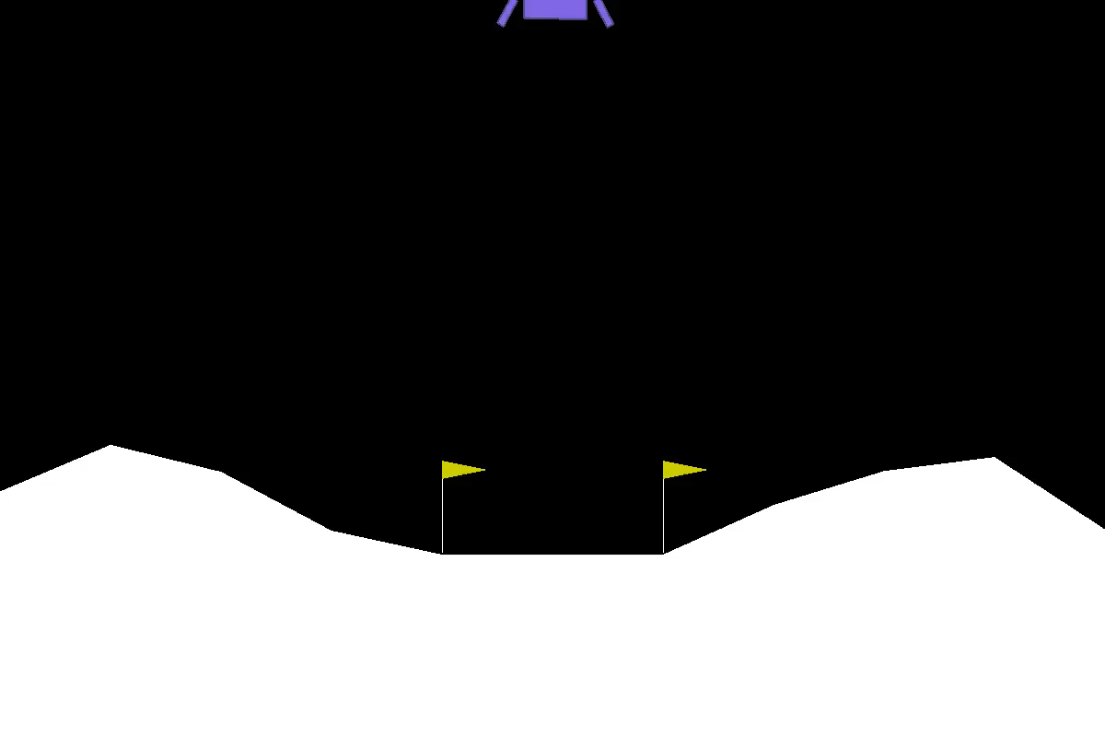
What is Lunar Lander?

Slide 3
What is Lunar Lander cont…
Atari videogame, trying to land a spacecraft between flags
4 Actions: do nothing, fire left, fire right, fire up
Game is ‘solved’ if routinely getting a score of 200+; perfect is 250
Environment created in OpenAI’s gym

Slide 4
How will we solve it?
Using deep reinforcement learning!

Slide 5
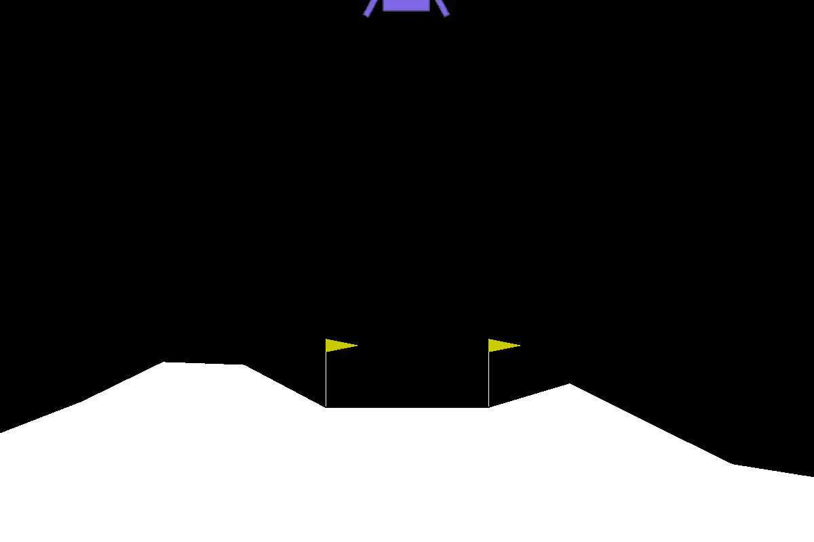
Untrained agent exploring actions

Slide 6
Training the agent: What is deep RL?
Taking an action taken returns <next_state, reward, done, info>
When we take an action, tell the agent to save:
<state_it_was_in, action_taken, reward_recieved, next_state>
<S, A, R, S’>
Agent starts by taking random actions and recording this information
Train the neural network: compare reward it thinks it will receive to the reward it actually receives, and minimize loss/optimize
Over time, it acts based on the neural network’s predictions

Slide 7
Deep RL Revisited

Slide 8
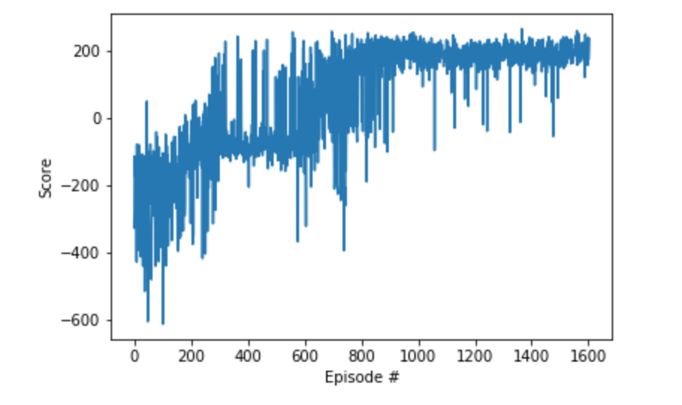
Visualizing the learning process

Slide 9
A trained agent!
Video will eventually go here!

Slide 10
How Could this be Useful?
Deep RL is a field of active research
Applications in:
Self-Driving Cars
Wayve – car drives in lane
(June 2018)
Robotics
Google X – robot picks up objects
(June 2018)

Slide 11
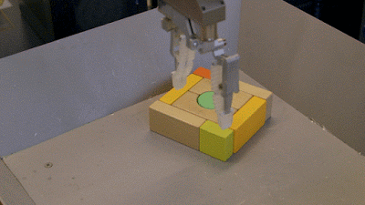

Slide 12
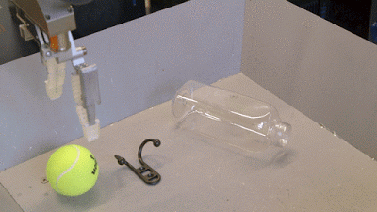

Slide 13
Future Work
Try different neural networks
Apply the agents to different games
Bridge gap between theory and real-world applications

